Slide 1







FINAL PROJECT
PLANE AND ROCKET
MSc Nguyen Trung Nghia

Slide 2









TEAM MEMBERS
Leader
NGUYEN HUY HOANG
NGUYEN DU NHAN
NGUYEN KHOI NGUYEN
ITCSIU21061
ITCSIU22140
ITITSB23006

Slide 3

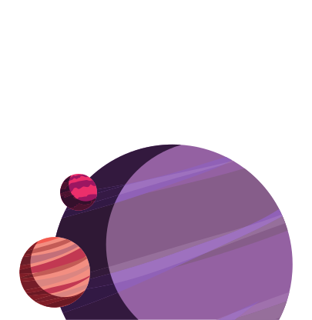


INTRODUCTION
Plane and Rocket is a 2D space shooter game made in Java. Players control a spaceship to dodge and destroy enemy rockets. The goal is to survive and get the highest score by destroying as many rockets as possible.

Slide 4
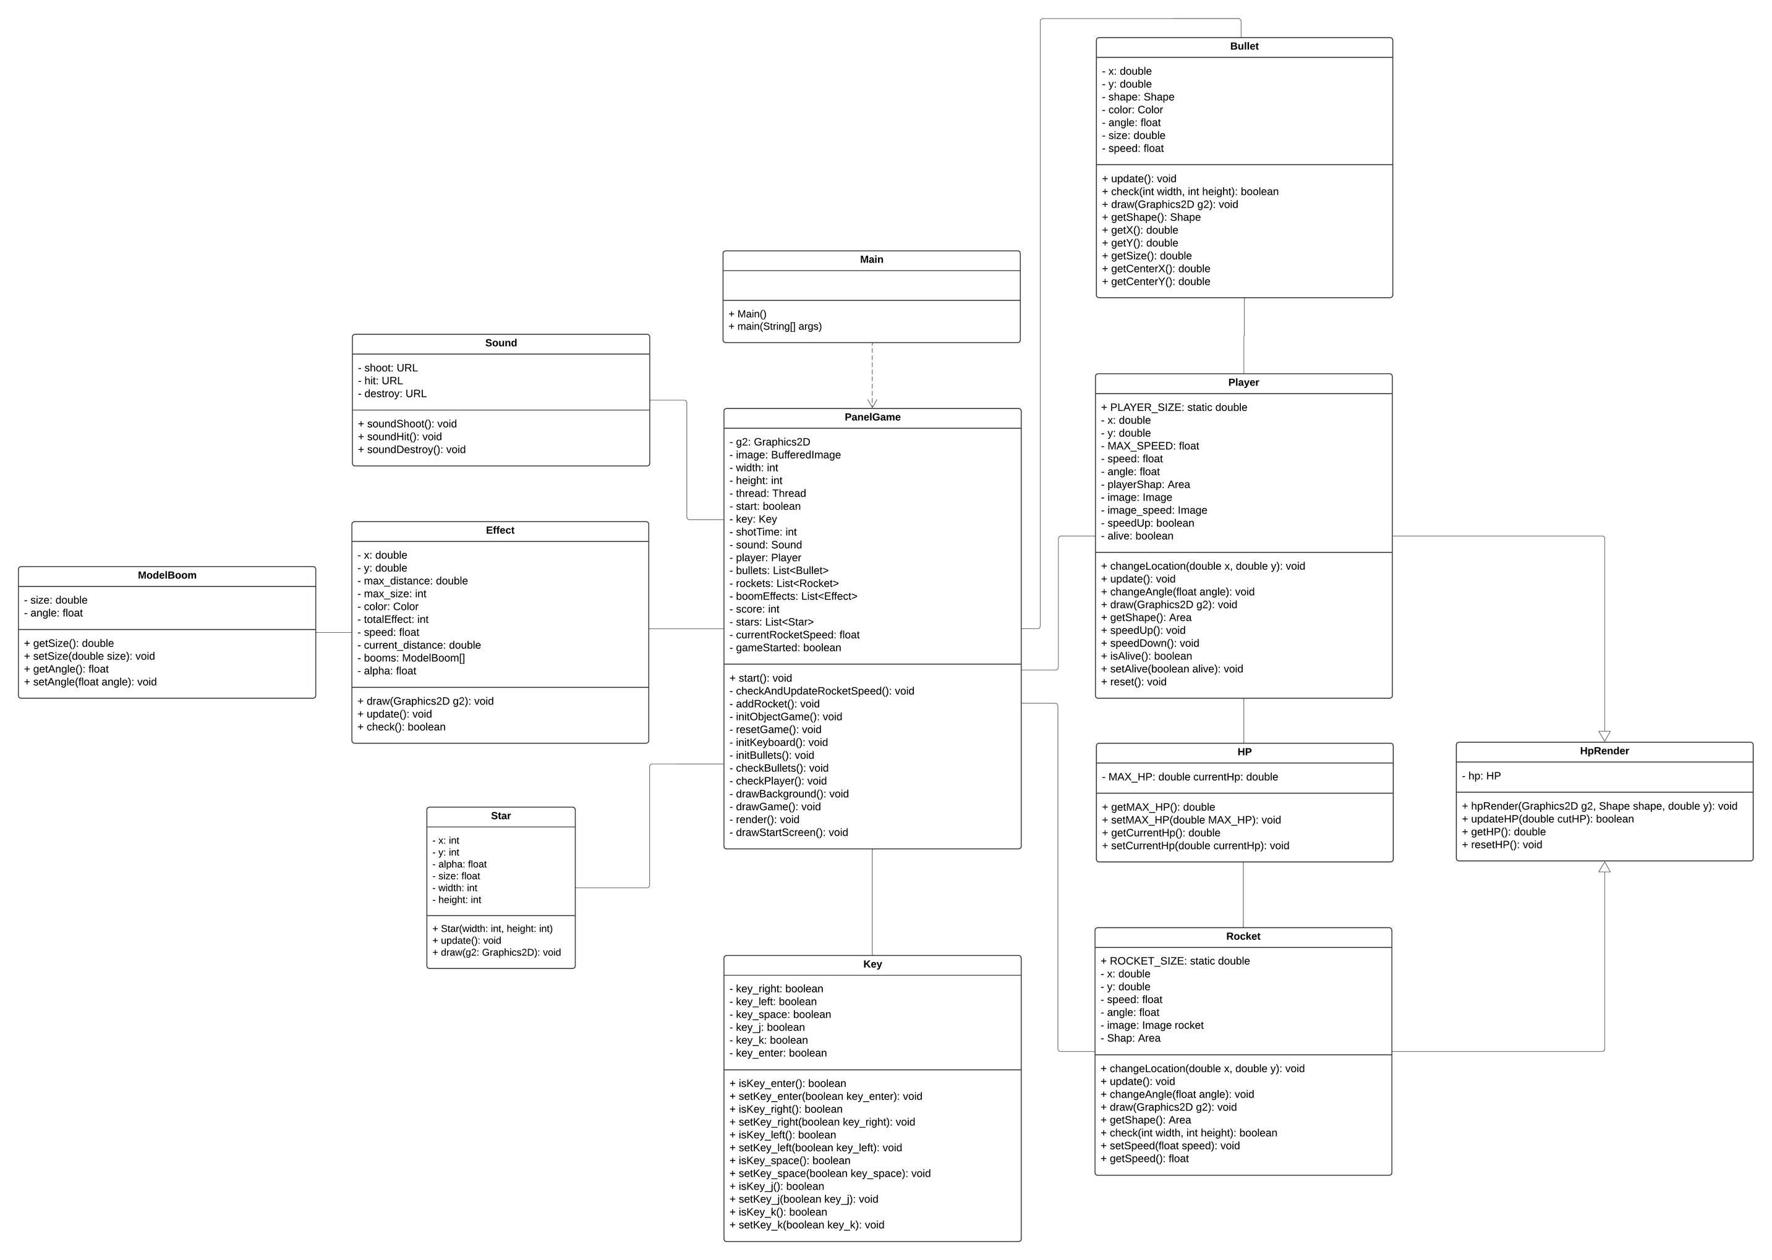
DESIGN
UML

Slide 5



KEY FEATURES
Rotational control and boosting speed mechanics.
Stunning effects and sounds.
Health and scoring system.

Slide 6
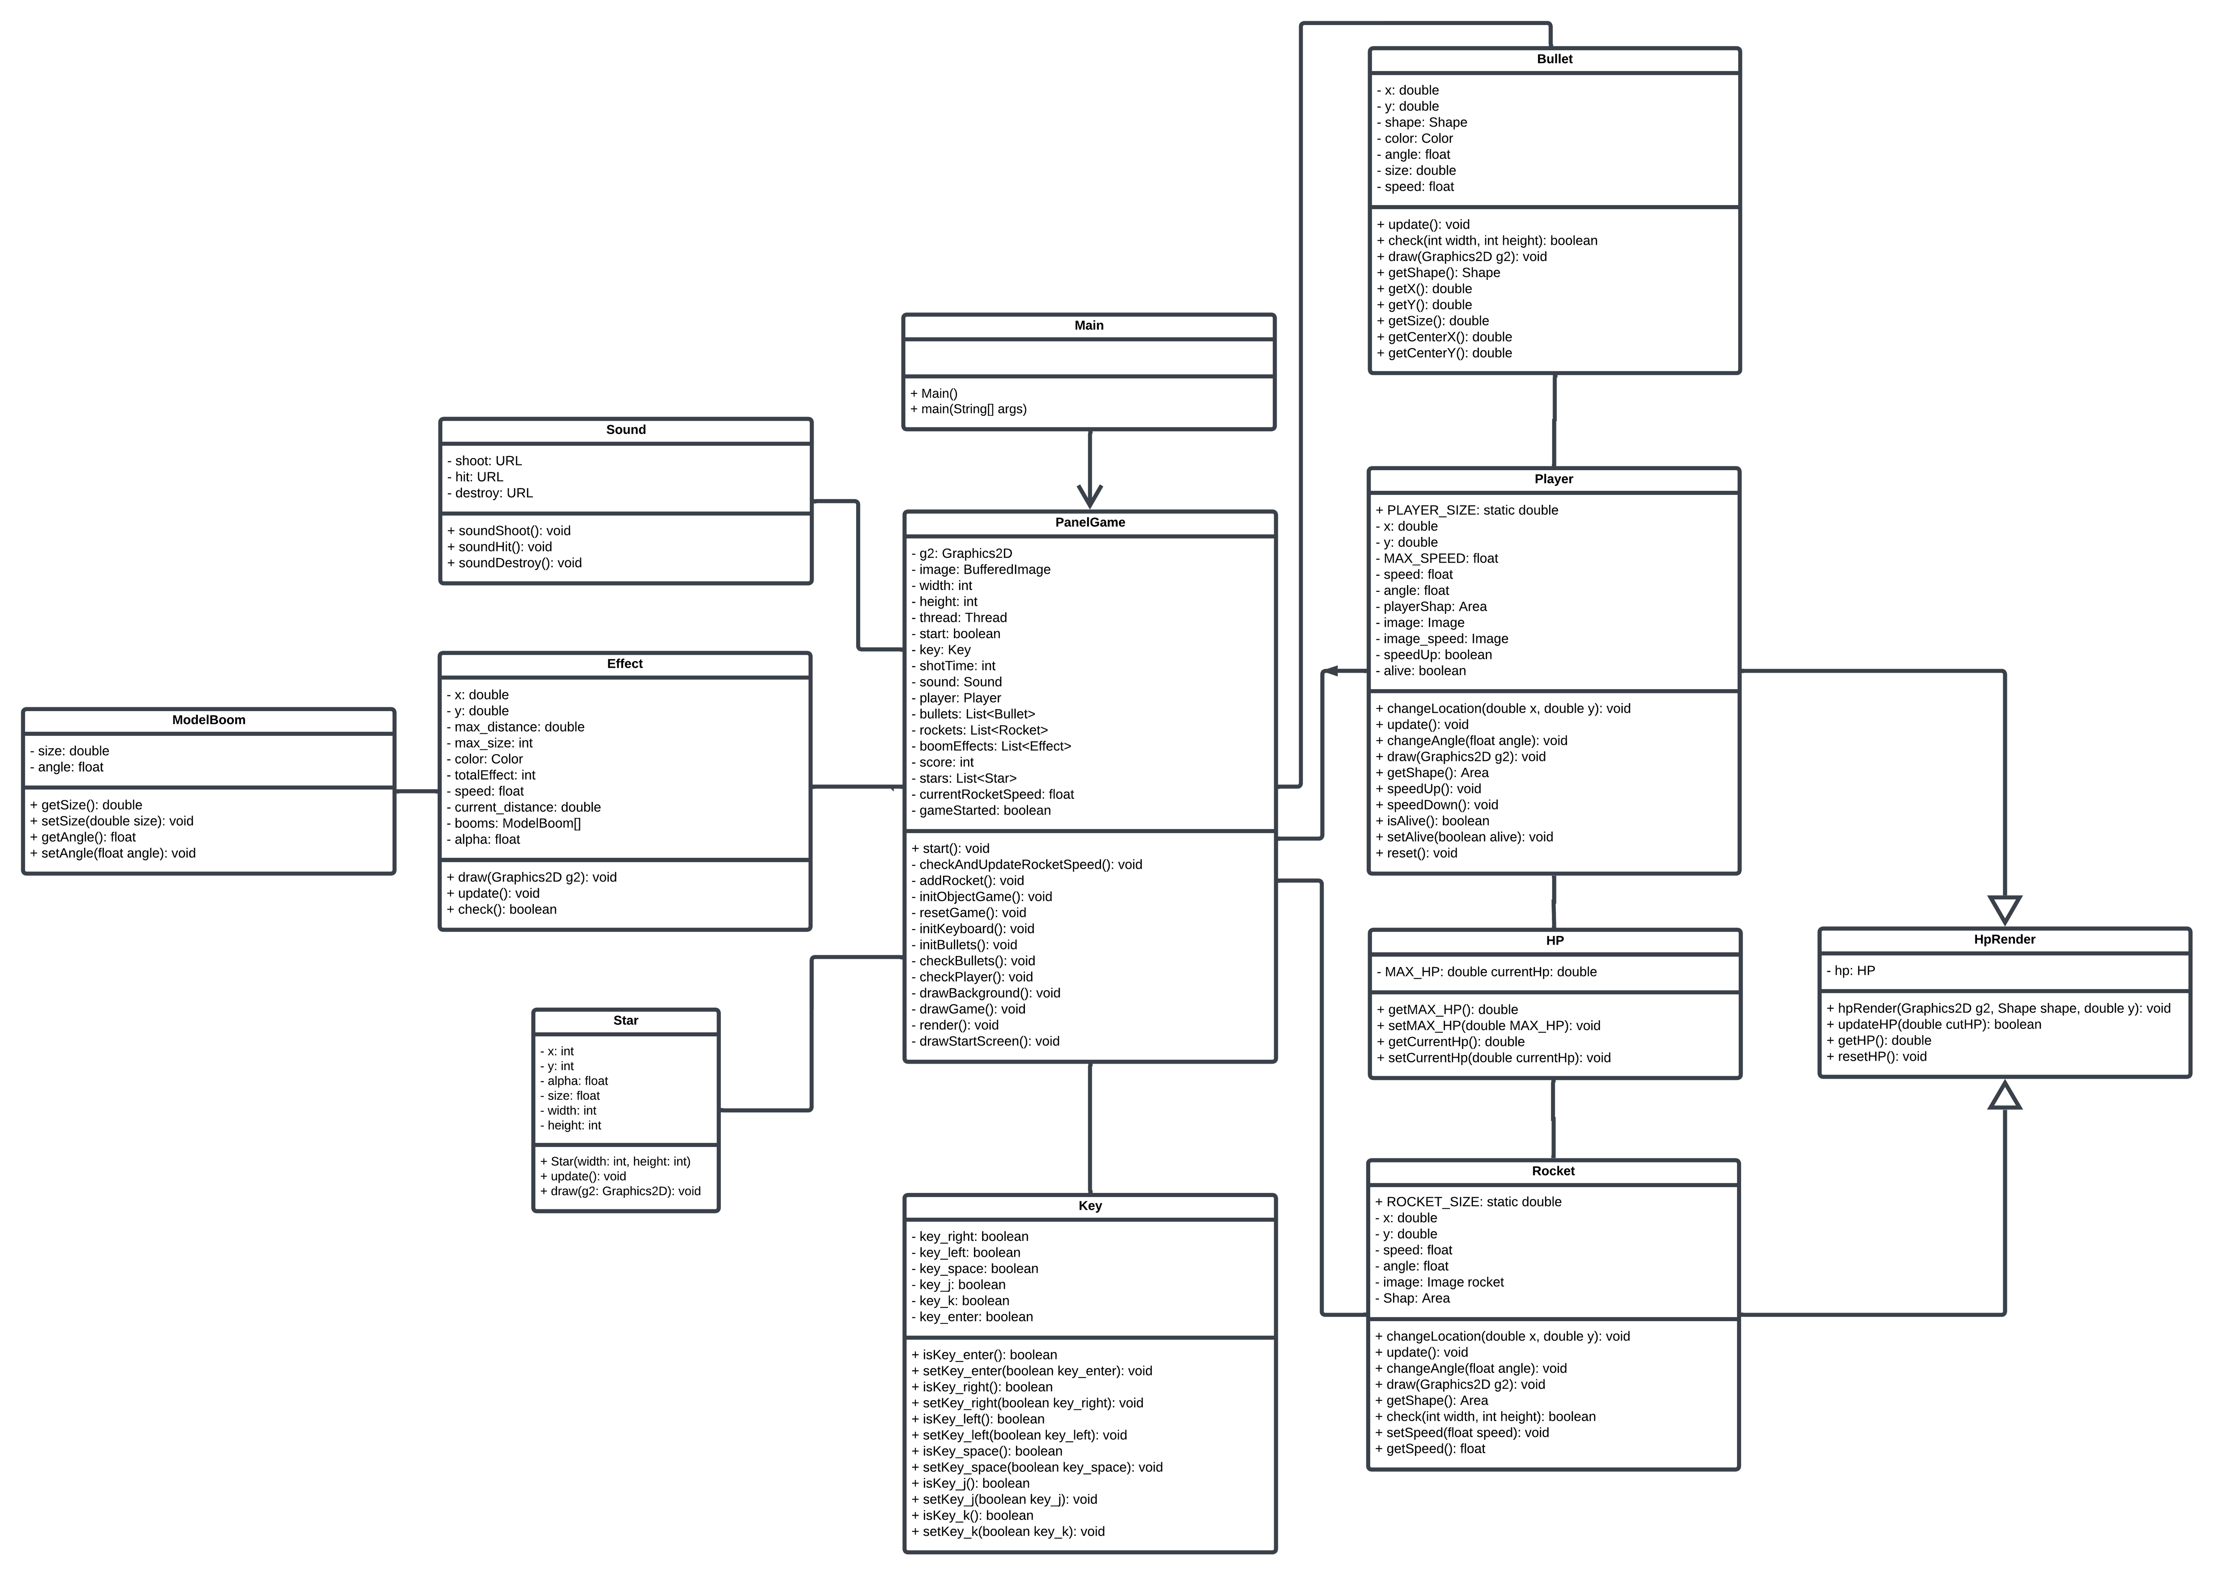
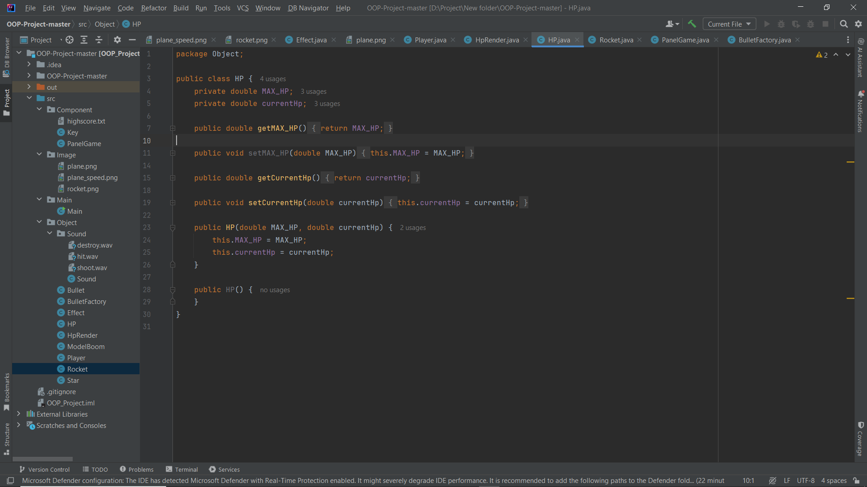
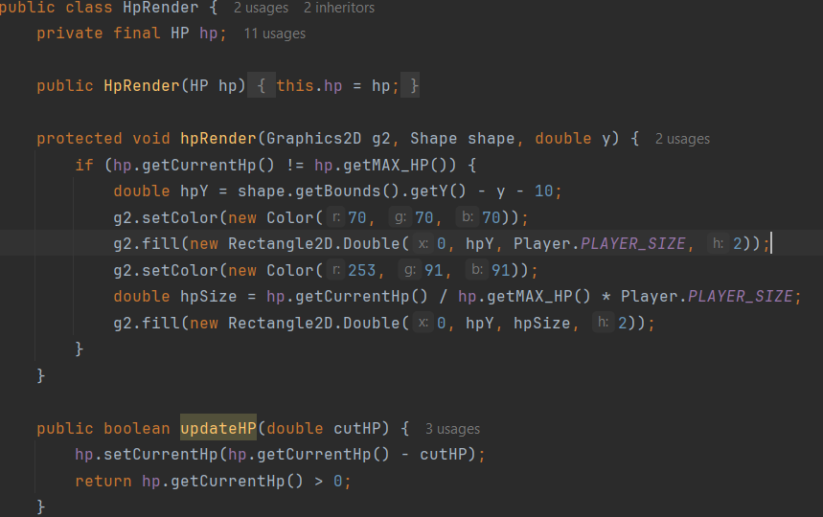
HP AND HP_RENDER
Method to setting Max_HP
Method to draw HP bar
Method to check the current HP

Slide 7

PLAYER
Method to rotated and moving the SpaceShip
Method to speed up and slow down the Space ship
Method to check if the Player is alive
Method to reset HP, position after restart
Method to draw the player

Slide 8
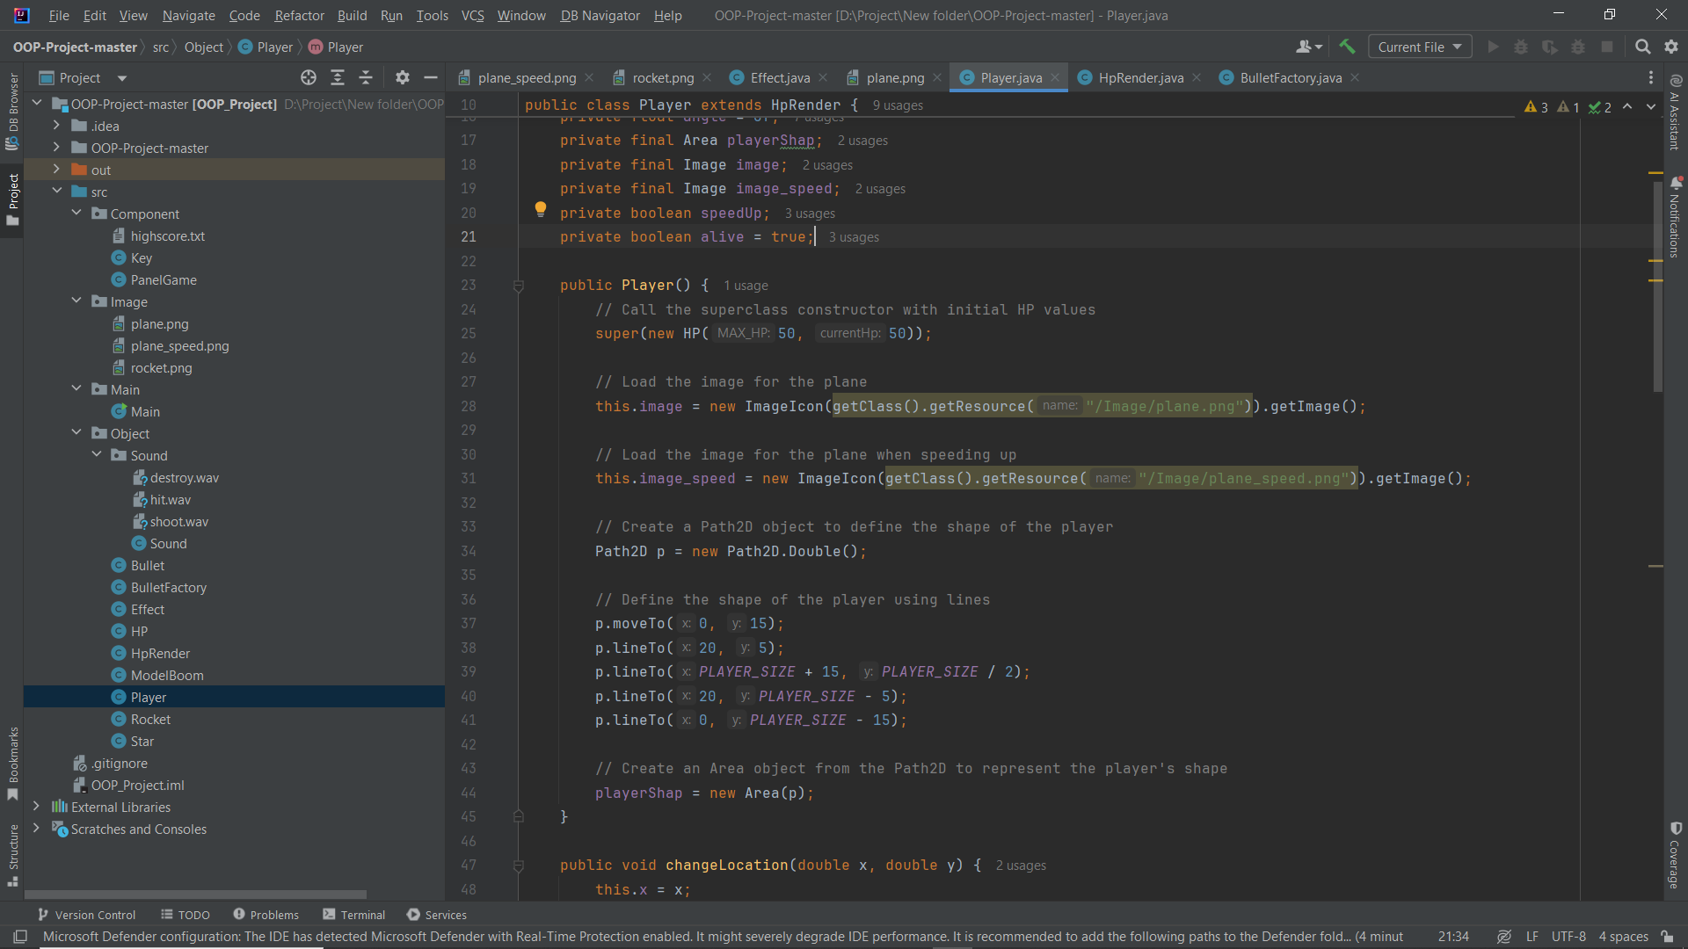

PLAYER
box

Slide 9


ROCKET
Method to check collision
Method to setting speed
Method to draw the enemy

Slide 10
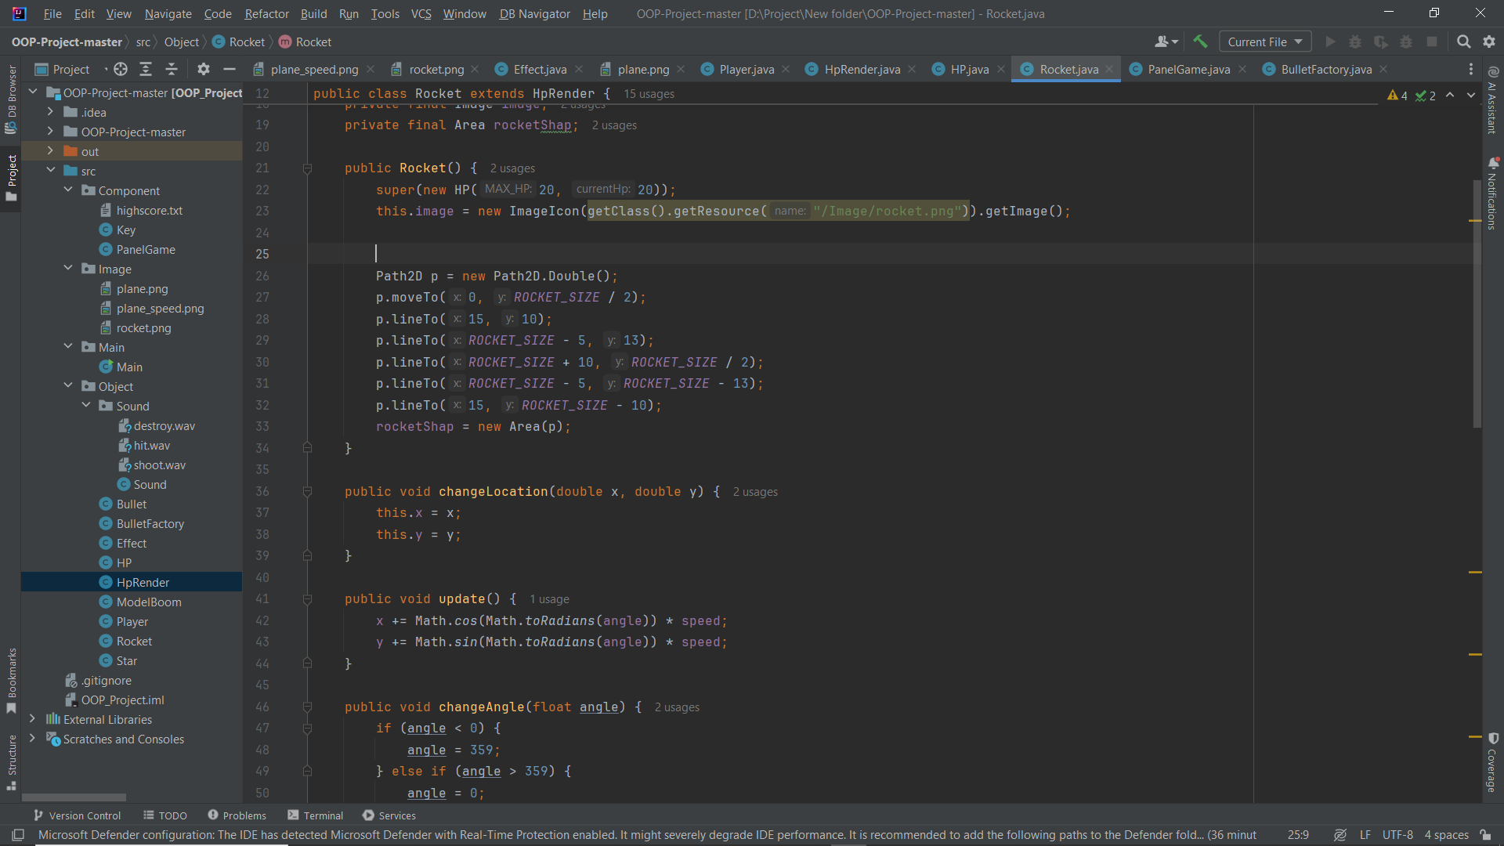
ROCKET

Slide 11
BULLET
Method to setting box of bullet
Method to draw the bullet

Slide 12
EXPLOSION EFFECT
Method to setting effect Booming
Method to check the condition when an enemy was defeated
Method to draw effect explosion

Slide 13
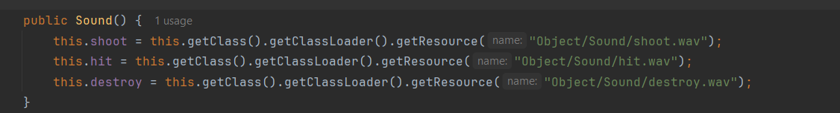
SOUND EFFECT
Method to set sound effect
👁 👁
👄
🙏

Slide 14
GAME PANEL
Method to .....
👀
👄
👉👈

Slide 15
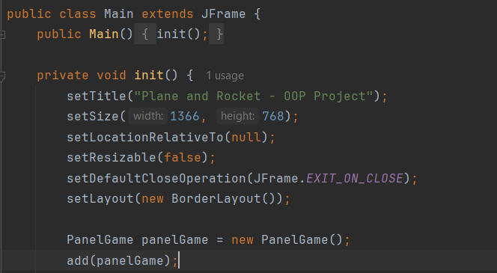
MAIN
Method to run the game

Slide 16


GAMEPLAY MECHANICS​
Press A
Press D
Speed up

Slide 17
GAMEPLAY MECHANICS​
Press J for shooting small bullets
Press K for shooting big bullets

Slide 18
GAMEPLAY MECHANICS​
Scoring system
=
1 Point

Slide 19




CONCLUSION
“Plane and Rocket” is a simple action game that tests players’ reflexes and strategic thinking.
Future improvements: Add levels, power-ups, and different enemy types.
゜゜
3

Slide 20




QUESTION
❓
Got any questions?
👀
👄
👉👈
I have an question

Slide 21


THANKS FOR
JOINING
OUR PRESENTATION!
👀
💋
👀
🖐
👀
💋
💋
🖐
🖐

